Slide 1

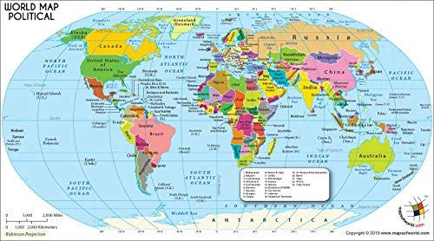
Mapping With R
By: Ayanthi Gunawardana
NYS GIS Association Mappy Hour
October 24, 2023
https://images-na.ssl-images-amazon.com/images/I/51iF%2BpUk3wL._AC_.jpg

Slide 2
Overview
About Me
What is R?
Why Use R for GIS?
Pros and Cons
The R Environment
Writing Code from Start to Finish
Map Examples
Resources

Slide 3


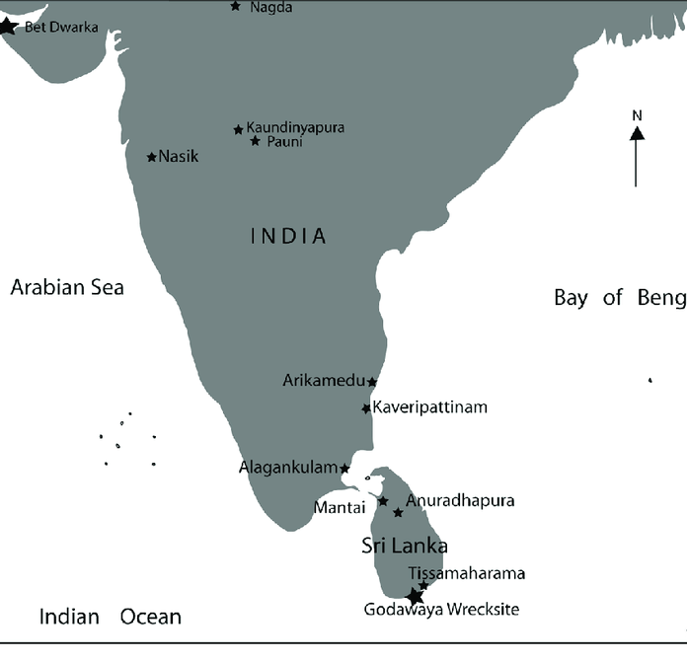
Who Am I?
B.A. in Sociology, Masters in City Planning
Spent 8 years working at the intersection (pun intended) of transportation and data at two NYC city agencies
Taking a break from city planning as a career, but am still interested in geospatial data and maps
R-Ladies NYC Board Member
https://www.meetup.com/rladies-newyork/
https://www.researchgate.net/profile/Rasika_Muthucumarana/publication/261016208/figure/fig1/AS:717197353689089@1548004582193/Map-of-India-and-Sri-Lanka-with-the-locations-of-major-archaeological-sites.png

Slide 4

What is R?
R is an open-source programming language
Primarily used in academic and STEM disciplines for statistical analysis
Strong data visualization capabilities
Its use has expanded over time as data analytics/data science has become more popular

Slide 5
Why Use R for GIS Work?
It’s free
Works well with large datasets
Quick data manipulation from built-in functions
Code allows for better reproducibility (unlike point and click in ArcMap)
Better availability of more complex geospatial functions and algorithms
Task automation

Slide 6
Cons of Using R as a GIS
Custom color palettes can be time-consuming to create
Placement of map elements can be hard and manual (picking the exact x/y coordinates)
Learning curve of using R
Hard, and not possible in some cases, to edit a shapefile if it’s broken

Slide 7
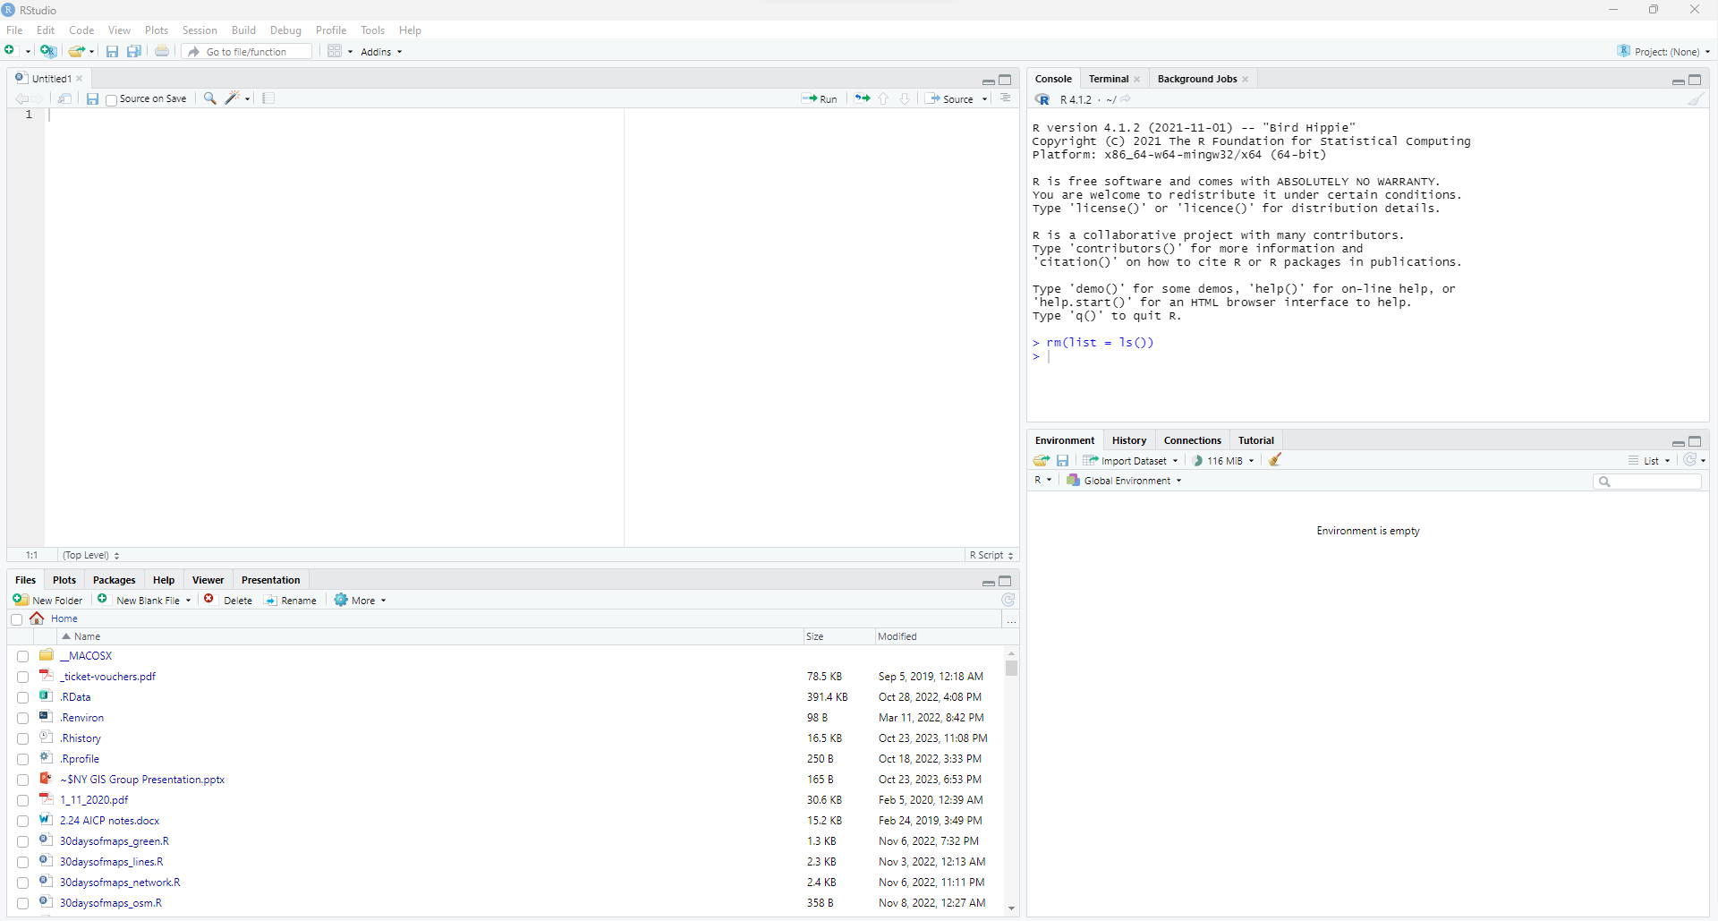
The R Environment
Console
Source
Environment
Files/
Viewer

Slide 8
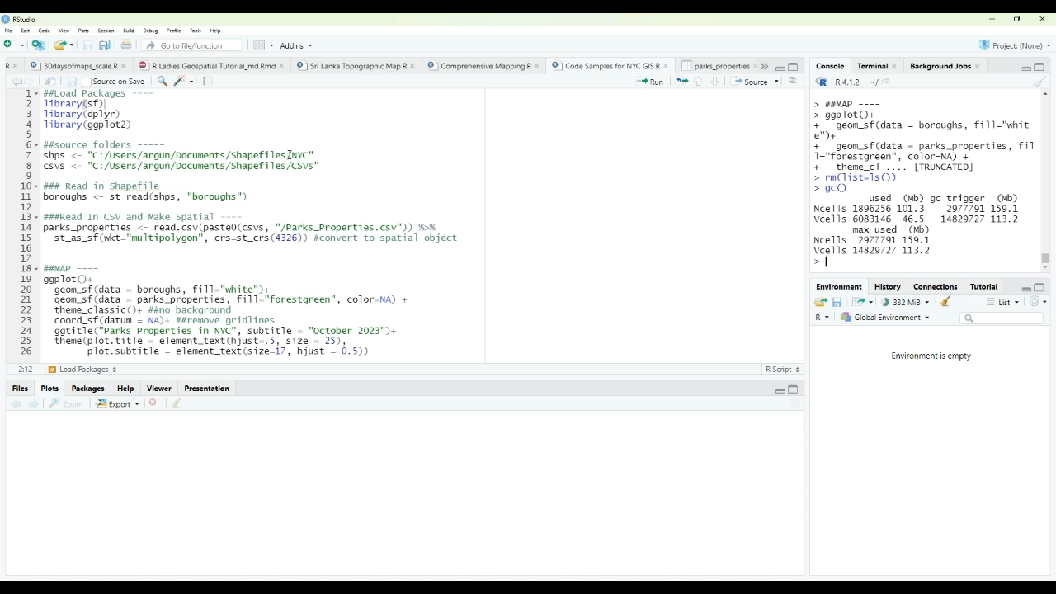
The R Environment In Action

Slide 9
Packages for Manipulating Spatial Data
sf: the main package for working with geometries and various spatial functions
Ggplot2: static maps
Mapview: interactive map viewing in the IDE
Ggspatial: custom map tiles and labels
Rgdal: formatting spatial file types (recently archived)
Tmap: static and dynamic maps
Cartography: create maps that look like more traditional GIS-software maps
Leaflet: shiny apps and dynamic visualizations
Tidycensus: extracting and manipulating census data
Rayshader: 3D maps
Raster: manipulating and visualizating raster data
Ggmap: uses google maps functionality for mapmaking
Tigris: additional census data

Slide 10
Writing Code From Start To Finish

Slide 11
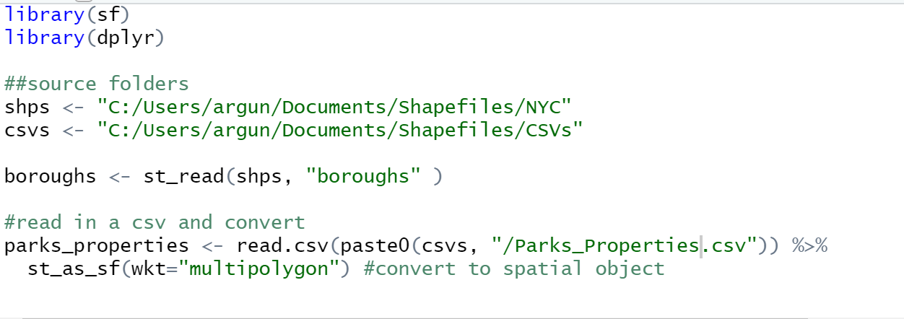
Working With Data in R
R has packages used to pull in and manipulate data
When you pull in data in R, you’re working with a copy of the source file in R’s memory
You’re not editing the actual file unless you choose to export it back into the source folder, replacing the original

Slide 12
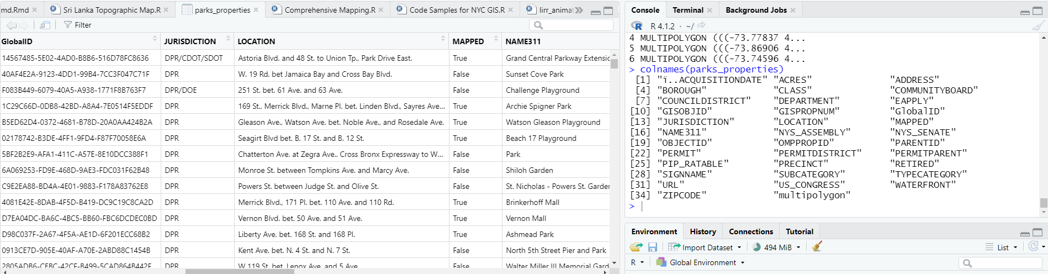
Exploratory Analysis
Run the command colnames() to see the column names
You can view the attribute table of the data in a separate tab

Slide 13
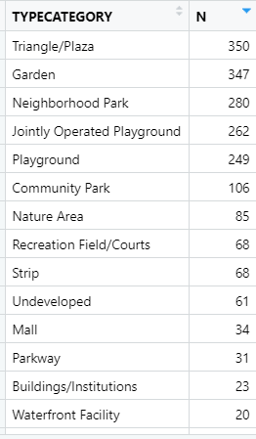
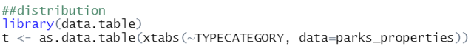
Exploratory Analysis
The xtabs command will give you a crosstab of one or more categories
Click the arrow on the column name to sort the table

Slide 14
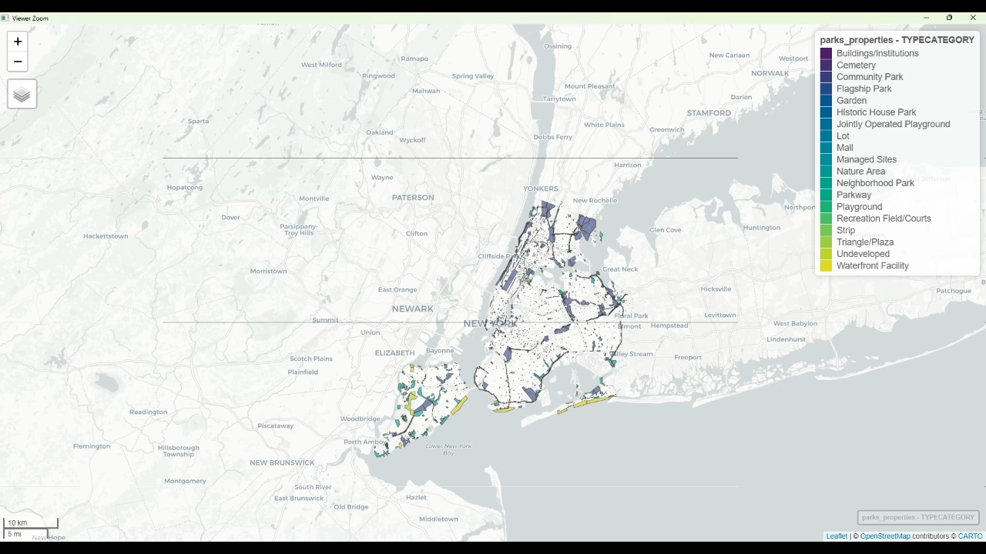
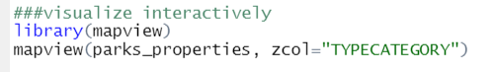
Exploratory Analysis - Interactive

Slide 15
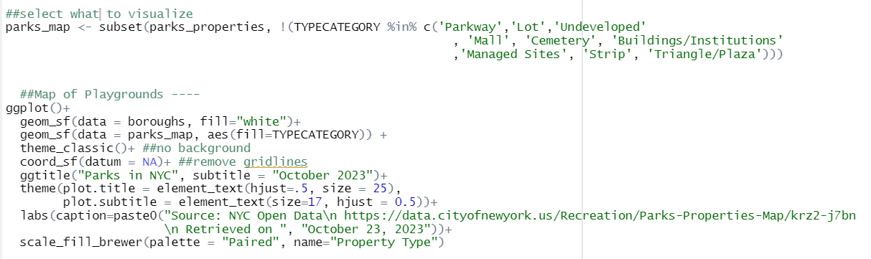
Deciding What to Plot

Slide 16

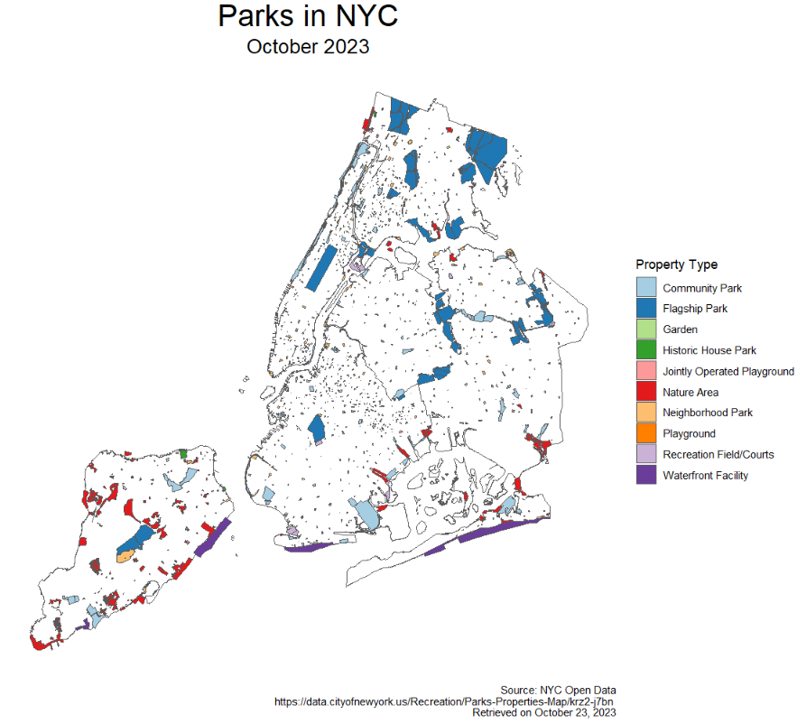
Final Plot

Slide 17
Examples of Maps Made in R

Slide 18
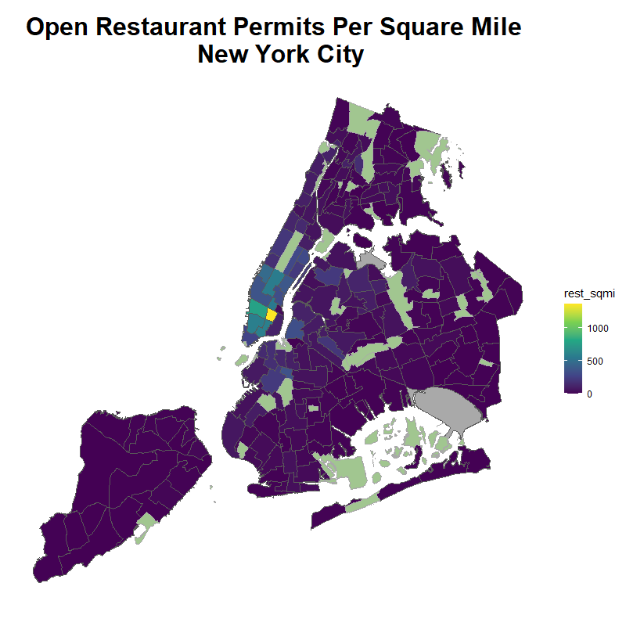
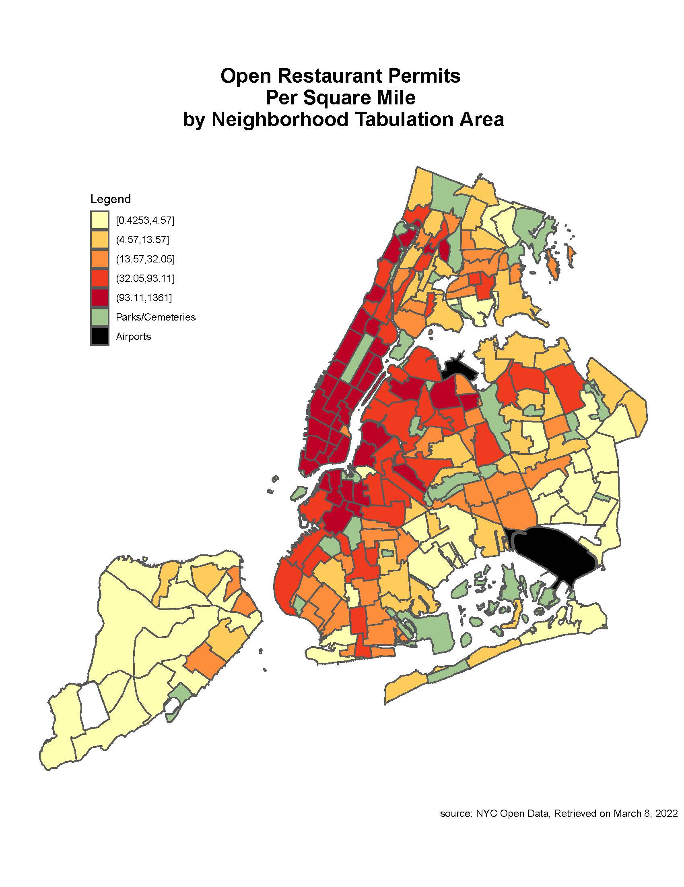

Slide 19
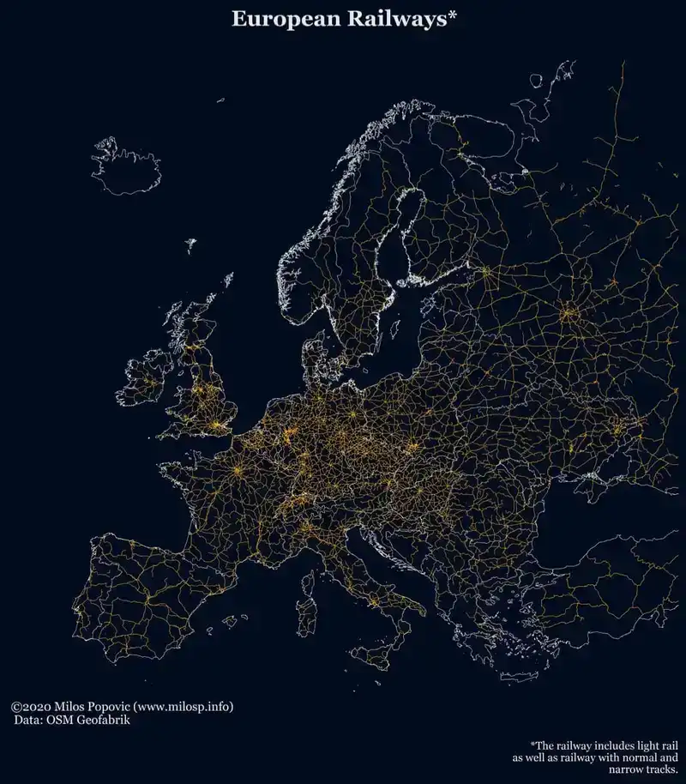
Source: https://milospopovic.net/maps/

Slide 20
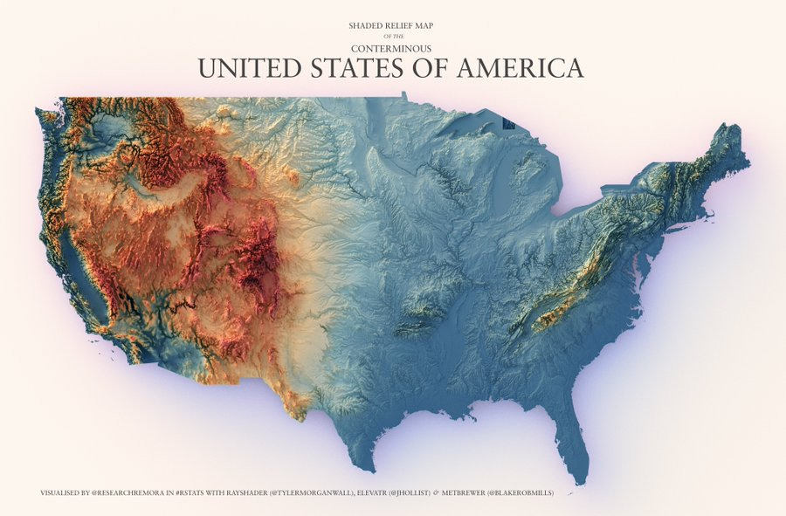
https://twitter.com/researchremora/status/1567930733087399936

Slide 21
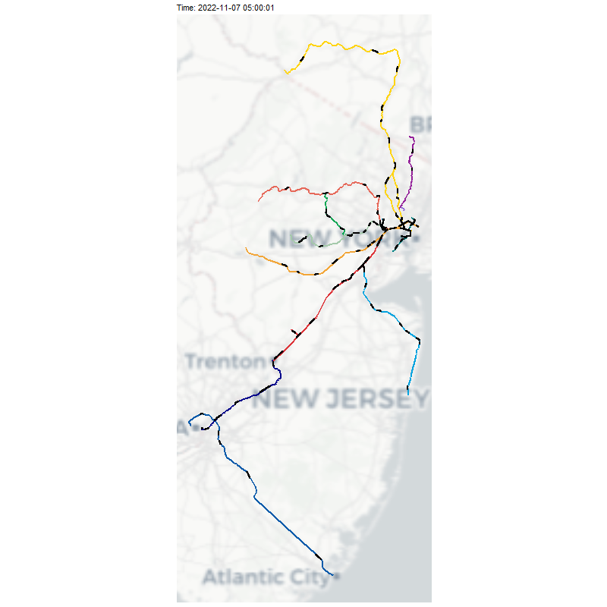
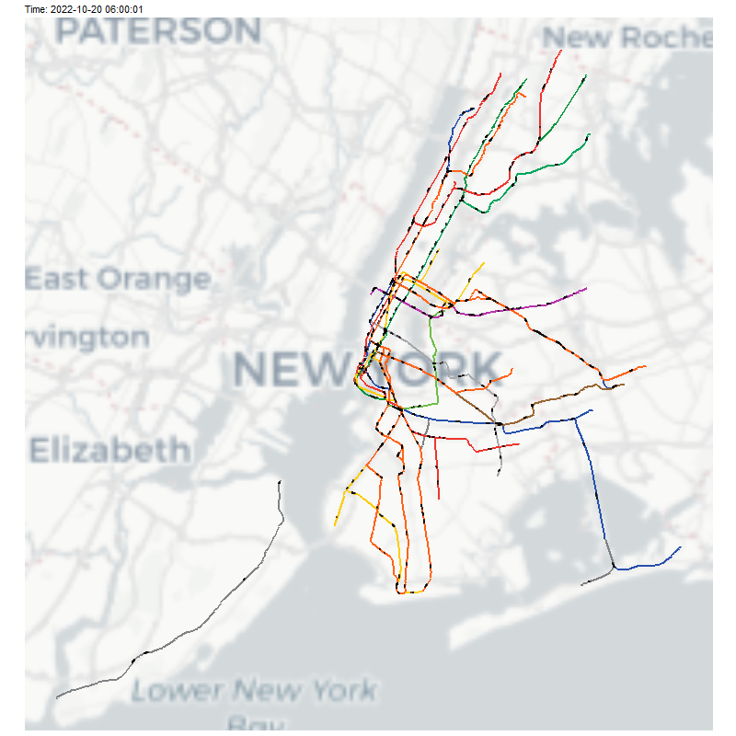

Slide 22
Useful Resources
Books
“How to Lie With Maps” by Mark Monmonnier
“Geocomputation in R” by Robin Lovelace, Jakub Nowosad, and Jannes Muenchow https://r.geocompx.org/
Geospatial Professionals with Educational Content
Matt Forrest: CARTO employee https://forrest.nyc/
Rafael H.M. Pereira: creator of some spatial R packages https://www.urbandemographics.org/about/
Milos Popovic: aesthetically pleasing maps in R https://milospopovic.net/
Kate Berg: environmental analysis in R: https://www.pokateomaps.com/
Robin Lovelace: big contributor to R geospatial community: https://www.robinlovelace.net/
Kyle Walker: R expert for census data: https://walker-data.com/

Slide 23
Thank You for Listening!
Github: https://github.com/argunaw

